Slide 1
Packet Switching (basics)

Slide 2
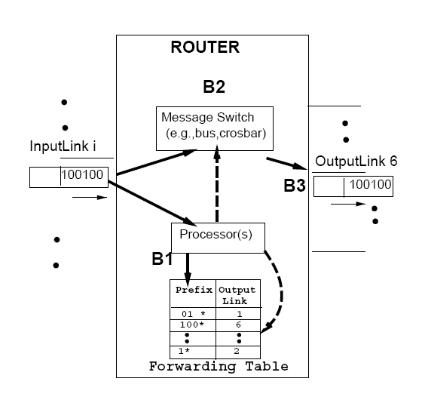

Slide 3
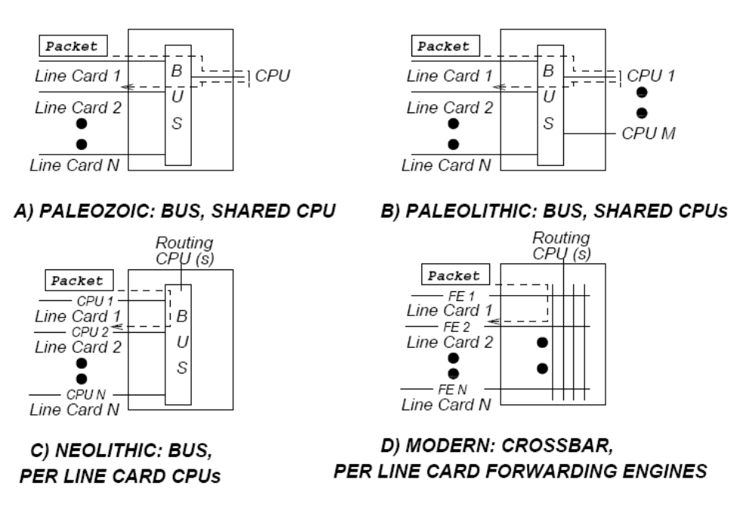

Slide 4
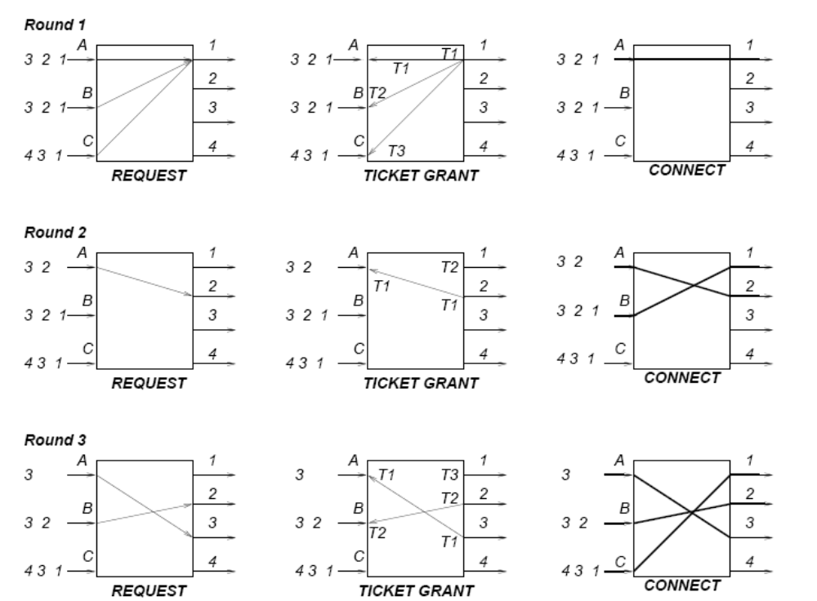
Crossbar scheduling: “Take-a-ticket”

Slide 5
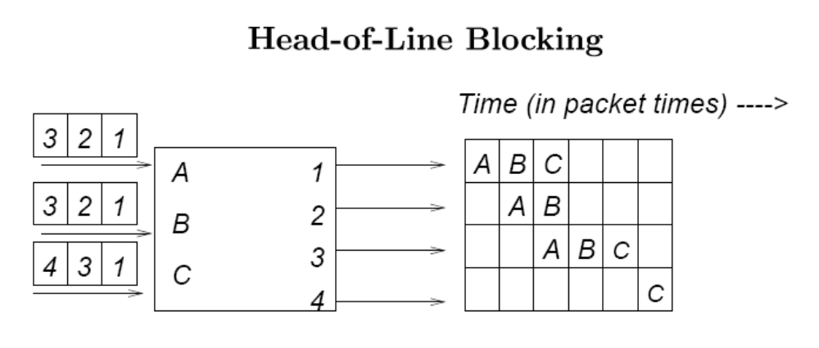
HOL
Probability that none of the N input ports chooses a given output port is (1-1/N)^{N} ≈ 37%
So, max throughput of this switch is: 63%

Slide 6
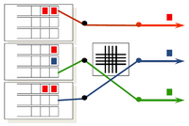
Avoid HOL-blocking with multiple input queues
(one per output port)

Slide 7
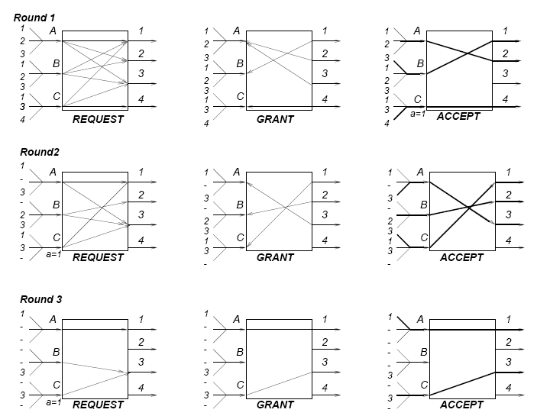
PIM: Parallel Iterative Matching

Slide 8
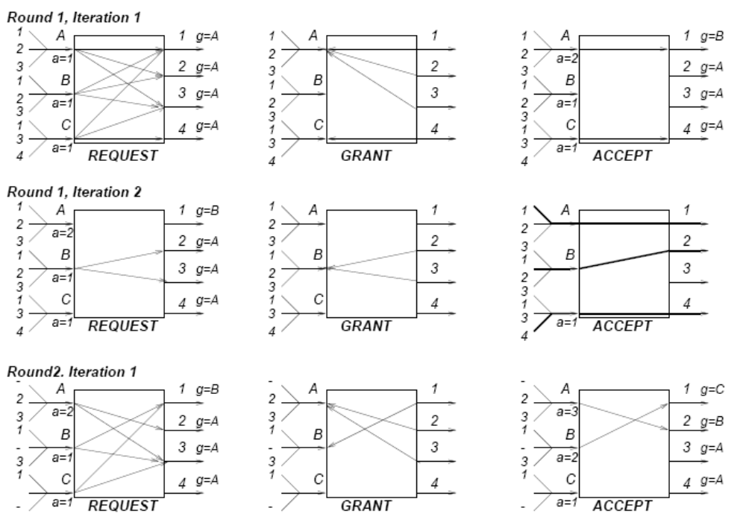
iSLIP (avoids randomization of PIM)

Slide 9
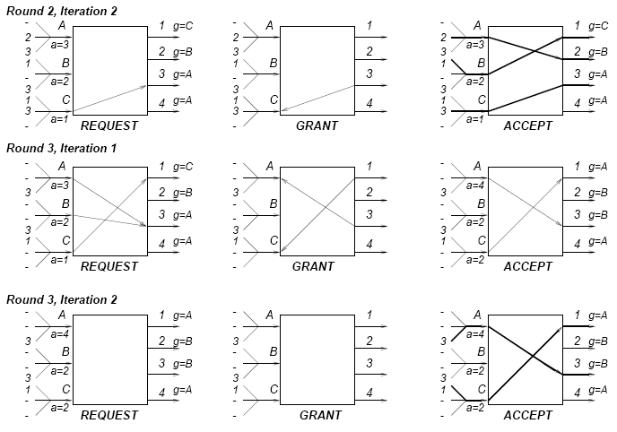
iSLIP (cont’)

Slide 10
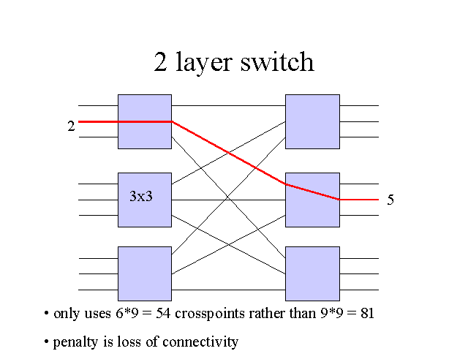
Multistage switching

Slide 11
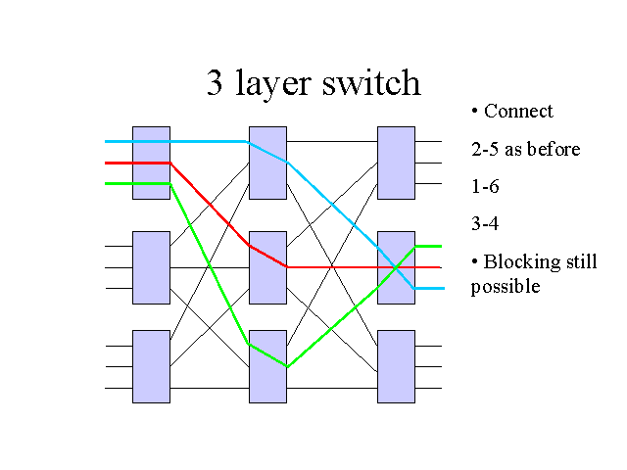
Blocking vs non-blocking switching networks

Slide 12
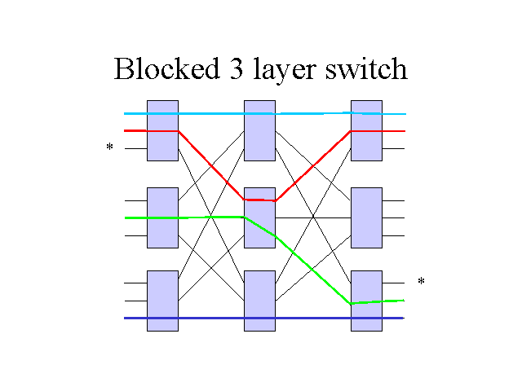
Blocking vs non-blocking switching networks

Slide 13
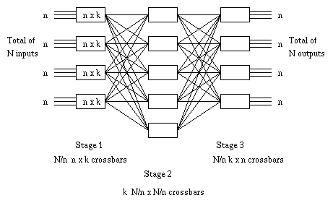
Clos network (N, n, k):
Non-blocking if k ≥2n-1 (Prove this!)

Slide 14
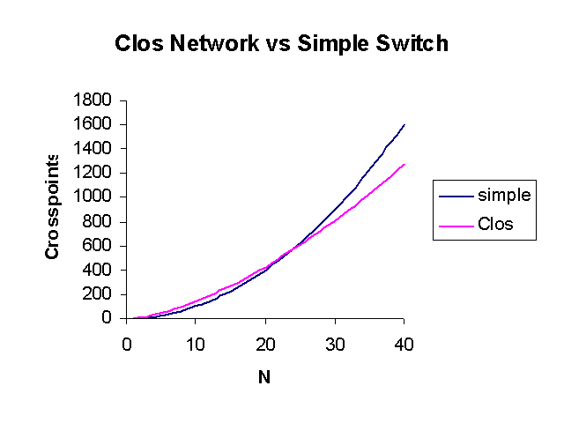
Clos network (N,n,k=2n-1):
Prove that min number of crosspoints = 5.6N√N (for n= √ (N/2)

Slide 15
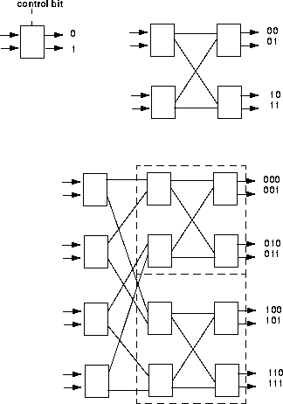

Banyan networks and the self-routing property

Slide 16
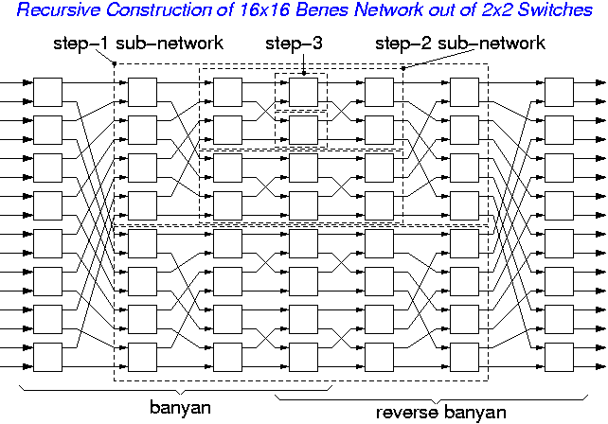
Benes network

Slide 17
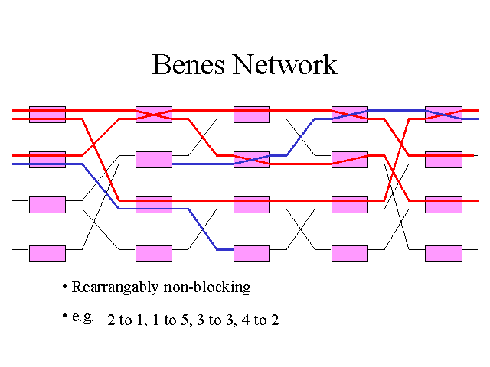

Slide 18
